Slide 1

2026-2027
GRANT MANAGEMENT TRAINING
District 7910
Saturday April 11, 2026
Ingrid Detweiler, DGSC Chair 2026-2027
District Grant Subcommittee
Joyce Fukami, Southboro, Peggy Sheldon, Marlboro, VPDG Victor Tom, Bedford
Jorge Yarzebski, Westboro

Slide 2
Vision Of Rotary
International
Together, we see a world where people unite and take action to create lasting change — across the globe, in our communities, and in ourselves.
The Rotary Foundation
OUR MISSION
The Rotary Foundation helps Rotary members to advance world understanding, goodwill, and peace by improving health, providing quality education, improving the environment, and alleviating poverty.

Slide 3
Training Agenda
1. Foundation Grants Overview, Club Qualification
2. District Grants in 2026-2027
  Requirements, Process, Timeline, Grant amount, Prior Examples, ClubRunner, Grants Module, Implementation, Report, Close-out
3. Global Grants in 2026-2027
  Requirements, Process, Timeline, Grant amount, Prior Examples, Funding, Best practices, Implementation, Report and Close-out

Slide 4
FOUNDATION GRANTS

Slide 5
FOUNDATION FUNDS
Annual Fund – Share*, supports humanitarian grants, scholarships, vocational training in any of the 7 Areas of Focus, Local and International. A percentage of member contributions comes back to the District for matching grant requests.
Annual Fund – Area of Focus specific funds
Specific Global Grant, direct to specific projects
Polio Plus Fund, donations matched 2:1 by Gates Foundation
Disaster Response Fund, fast funding
Endowment Fund, major gifts or bequests of $10,000 or more.

Slide 6







Rotary 7 Areas Of Focus
Providing Clean Water
Fighting Disease
Enhancing Maternal and Child Health
Supporting Education and Literacy
Growing Local Economies
Promoting Peace
Protecting Our Environment

Slide 7

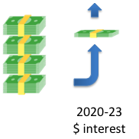

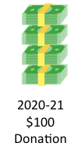

How Your AF-Share Donation Returns to D7910
$47.50
TRF
Holds Funds for
3 years.
Spends 5% + Interest to Manage Grants
World Fund
TRF
AF-Share
District Designated Fund
D7910
$47.50
District Grants
Global Grants
2022-23 $100
Donation
2025-26 $5 + $ interest

Slide 8
DISTRICT PROJECTS
Last 6 Years for District Grants
*
*Includes 1 large multiclub project

Slide 9
THREE TYPES OF GRANTS
In 2026-2027
District Grants:
Approximately $28,000. will be available for clubs in our district
Funds smaller projects often local but can be international
Global Grants:
About $43,000. carried forward and $28,000. new, total $71,000.
All international, for humanitarian projects, scholarships or vocational training
Disaster Response:
No District limit

Slide 10
TO BE QUALIFIED TO RECEIVE A GRANT
CLUB MUST
1. Sign Memorandum Of Understanding (MOU) by Club President President-Elect .
  Have at least 1 club member who has completed Grant Training within the last 3 years.
  Appoint a Club Foundation Chair and List in Clubrunner
  Set Foundation Annual Fund Share Goal in Clubrunner
  Close previous year Club District Grant

Slide 11
MAINTAIN CLUB QUALIFICATION
Maintain good standing under the District rules
Comply with all qualification criteria
Ensure compliance with the Club MOU
  Appoint a club member or committee – Club Foundation Chair can lead the effort
Fully implement stewardship practices to prevent misuse of funds

Slide 12
GRANT DISTRICT DECISIONS
Recommended by the District Grants Subcommittee
  Chair, DGSC Ingrid Detweiler.
  Some key decisions are:
    Approval of DDF for global and district grants, and other Foundation Funds
    Review procedures for applications including scoring rubric
    District sponsored grants to address common needs in communities
Recommendations are then endorsed by the District Rotary Foundation Committee
  Chair, DRFC Bob Worth
  For Global Grants the Foundation Advisory Board (FAB) reviews and approves
    comprising DG Chain, DRFC, DGSC.
TRF gives final approval then sends funds to the District

Slide 13
Foundation Advisory Board (FAB) 2026-2027
DG Penny Hamel
DGE Jack Colamaria, DGN Susan Wilkenson
DRFC Bob Worth
DGSC Ingrid Detweiler
Ingrid Detweiler, DGSC Chair 2026-2027
District Grant Subcommittee
Joyce Fukami, Southboro, Peggy Sheldon, Marlboro, VPDG Victor Tom, Bedford
Jorge Yarzebski, Westboro

Slide 14
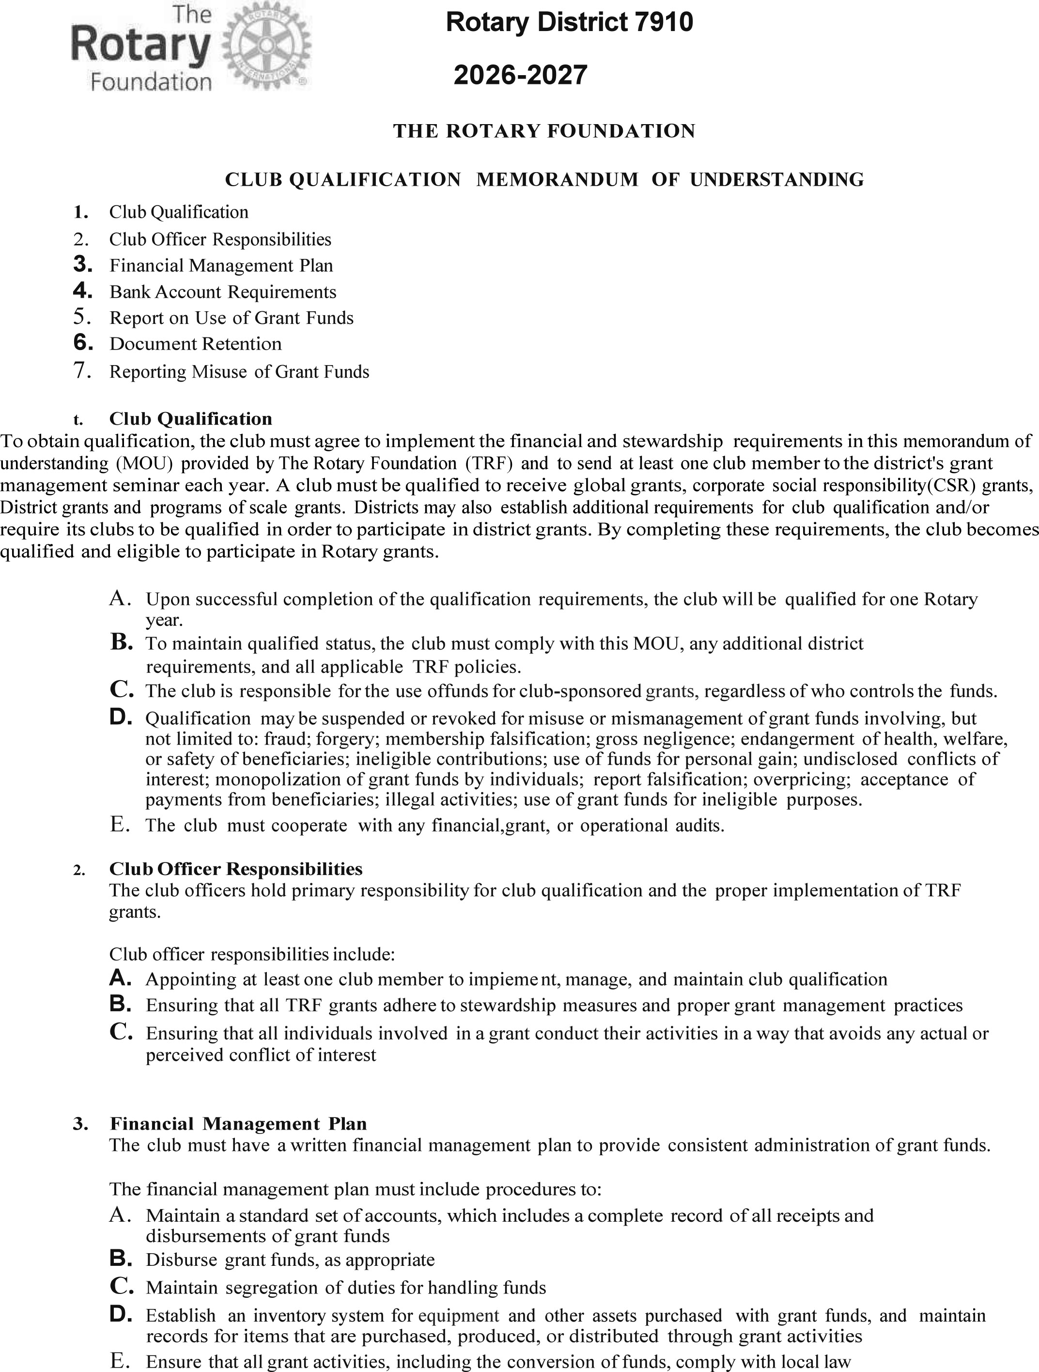

Slide 15
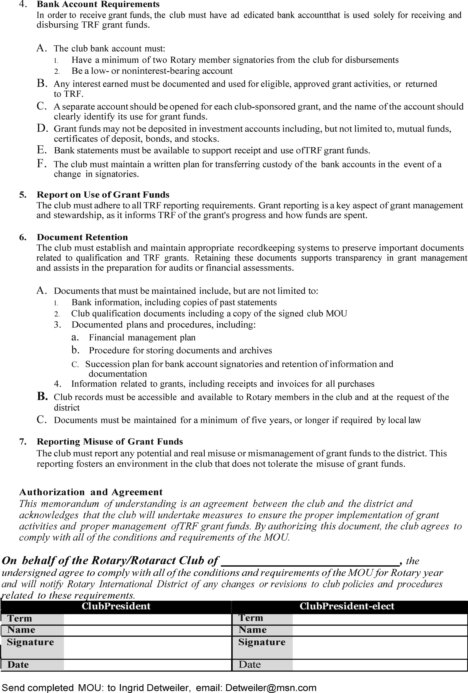

Slide 16
        DISTRICT GRANT REQUIREMENTS
Fund small-scale, short-term projects that address immediate needs in your community or abroad
All projects must
  Relate to the mission of The Rotary Foundation
  Include the active participation of Rotarians
  Comply with conflict-of-interest policy
    No Rotarian benefits financially or personally from a grant
    Benefit cannot be direct to a Rotarian or indirect to an associate of the Rotarian
  Be a new project
  Cannot begin until approved by the District
  Avoid continuous or excessive support of any one beneficiary, entity, or community

Slide 17
DISTRICT GRANT NOTES
Multi-club involvement and non-Rotarian participation in district grants is encouraged
Get ideas from past District Grant List
District sponsored projects focusing on common needs in multiple communities may be undertaken to get more clubs to participate
Only one District Grant per club – Rotary/Rotaract/Interact
Up to $3,000 may be requested. Range is $1,000 to $3,000

Slide 18
SUCCESSFUL DISTRICT GRANTS
Have achievable goals
Meet community needs
Are sustainable
Involve a partner
  Other Rotary Club(s) or Non-Rotary entity(ies) (learn how another club has run a project)
  Help identify and recruit new members
Have an implementation plan
Maintain proper stewardship of funds

Slide 19
 |  | Rotary District 7910
 |  | District Grants 2025-2026
Club | Grant# | Project | Area Of Focus | Project Amount | Request | Approved*
Leominster |  | 100K Meals for 100 Years | Maternal And Child Health | 35,000.00 | 19,500.00 | 8,401.25
Concord |  | Concord Recreation Program Enhancements | Basic Ed And Literacy | 5,000.00 | 2,500.00 | 1,875.00
Shrewsbury |  | Diaper Pantry Service | Water And Sanitation | 3,708.00 | 1,853.00 | 1,389.75
Athol-Orange |  | N. Quabbin Foodathon | Economic And Community Development | 5,000.00 | 2,000.00 | 1,500.00
Westborough |  | Peace Pole | Peace And Conflict Resolution | 3,016.00 | 1,500.00 | 1,125.00
Nashoba |  | World Farmers Greenhouse Project | Economic And Community Development | 6,000.00 | 3,000.00 | 2,250.00
Blackstone Valley |  | Fighting Hunger In Blackstone Valley | Maternal And Child Health | 4,000.00 | 2,000.00 | 1,500.00
Southborough |  | Foldscopes | Basic Ed And Literacy | 1,000.00 | 500.00 | 375.00
Bedford |  | Monthly Community Dinners | Economic And Community Development | 4,000.00 | 2,000.00 | 1,500.00
Northborough |  | Nutrition 68 | Maternal And Child Health | 9,000.00 | 2,000.00 | 1,500.00
Total Grants |  |  |  |  |  | 21,416.00

Slide 20
Accessing The District Grant Module
Step 1: Log into www.Rotary7910.org
Step 2: Click on Member Login and log in as a D7910 member
Step 3: Click on Member Area in the upper right-hand side
Step 4: Click on Grants and then on “Submit a Grant Request”
Step 5: Fill in Submit a Grant request and wait for approval
Step 6: Fill in Application Tab, Budget Tab, Documents Tab
Step 7: Complete and upload Rubric

Slide 23
Scoring Rubric – An Example
1 to 5 scale, 11 measures
Maximum score: 53, Minimum Required Score: 20
1 to 5 scale, 11 measures |  |  |  |  |  |  | "Project Score" is computed when the values you determine for each measure is entered in the "Value for Project" column.
Maximum score: 53, Minimum Required Score: 20
Evaluation Criteria |  | Score for different Values
Category | Measure | 1 | 2 | 3 | 4 | 5 | Value | Score
Impact | Beneficiaries | 1 to 5 | 6 to 8 | 9 to 15 | 16 to 25 | >25 | 100 | 5
 | DG Focus: Peace |  |  |  |  | Y or n | y | 5
Sponsor Club | Rotarians | 1 to 3 | 4 to 8 | 9 to12 | 13 to 20 | >20 | 20 | 4
 | Volunteer Hours | 1 to 5 | 6 to 10 | 11 to 20 | 21 to 30 | >30 | 300 | 5
 |  |  |  | y or n |  |  | n | 0
Non-Rotarian Entity | Funding support | $1 - 50 | $51-100 | $101-200 | $201-300 | >$300 | 200 | 3
 | Volunteers | 1 to 2 | 3 to 5 | 6 to 9 | 10 to 15 | >15 | 10 | 4
 | Volunteer Hours | 1 to 2 | 3 to 4 | 5 to 6 | 7 to 10 | >10 | 25 | 5
Other Rotary Clubs | Clubs |  |  | 1 |  | >1 | 1 | 3
 | Funding support | $1-50 | 51-100 | $101-200 | $201-300 | >$300 | 250 | 4
 | Volunteer Hours | 1 to 2 | 3 to 5 | 6 to 9 | 10 to 15 | >15 | 15 | 4
 |  |  |  |  |  | TOTAL SCORE |  | 42
Club Size
Less then 15
Smal

Slide 24

Pay Special Attention
Year at the top of the page says 2026-2027
Your club MUST be qualified in order to begin the application
  If club qualified last year, module will allow you to enter a grant in that year (2024-2025), but that will not count and may not be seen by the Grant committee.
Enter grant amount requested in the budget tab
Rubric score must exceed 20
Extra Points for DG Area Of Focus: Peace And Conflict Resolution

Slide 25
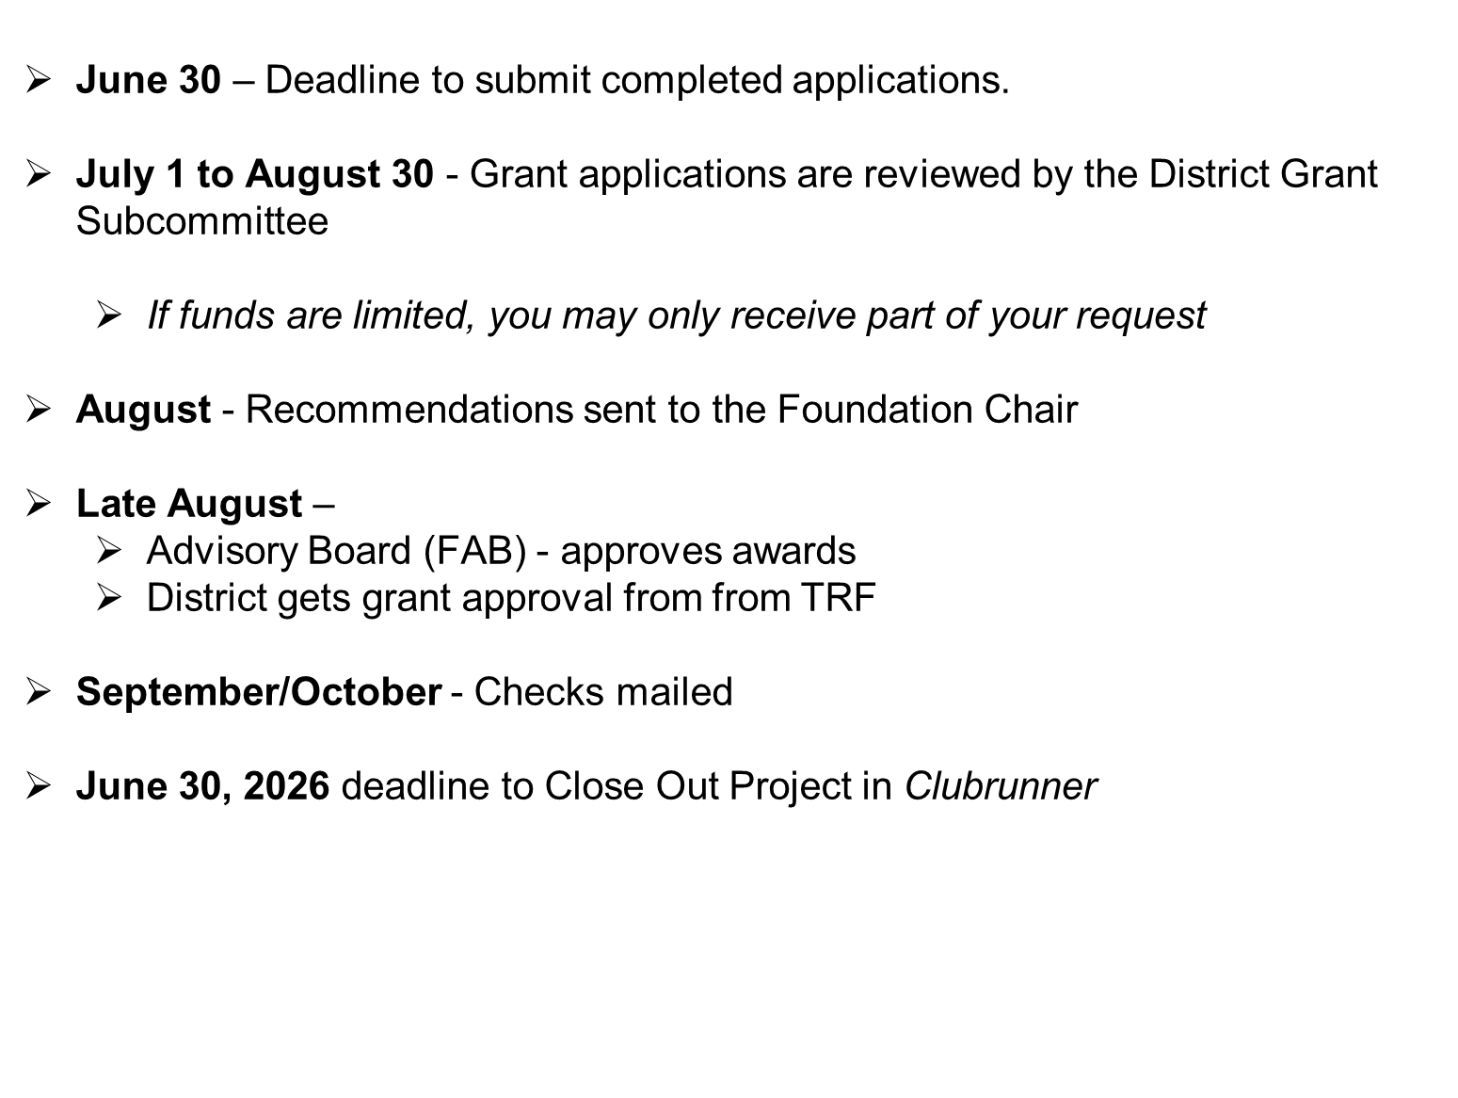
GRANT PROCESS

Slide 26
Before receiving your check…
1. Open a dedicated checking account
2. Deposit your club’s contribution into the account
3. Upload bank statement to Clubrunner showing your deposit
a. ALL project transactions must go through this account.
b. It is ok to lend money to the dedicated District Grant account, while you wait for your
check, and repay after receiving the check
4. Provide address where the check should be mailed.

Slide 27
CREATING A BUDGET
            Realistic
            Competitive bidding (costly items)
            Reasonable prices
            Avoid direct donations to beneficiaries
            Disclose conflicts of interest
                Partners, Beneficiaries or suppliers

Slide 28
DISTRICT GRANT IMPLEMENTATION
Conduct all activities described in the application
Inform the DGSC if any significant changes needed to be made
Document the activities of the project with pictures and reports
Keep records, receipts and retain them
Publicize the project on club and district web sites, social media and local media – newspapers, TV etc.

Slide 29
STEWARDSHIP
Stewardship is the responsible management and oversight of grant funds, including:
            Reporting any irregularities
            Financial records review
            Oversight of funds
            Avoid direct payment to beneficiaries
            Timely submission of reports
            All transactions through grant account

Slide 30
DISTRICT GRANT PROJECT REPORTS
Final Report submitted online in the tab “Individual Project Report”
    Answer 6 questions
    Fill out Final Accounting
Upload required supporting documents in the tab “documents”
    Bank statements (showing project costs. Funds received/spent)
    Copies of canceled checks
    Receipts/invoices for items purchased
    Photos of the project activities
    Acknowledgment letters from beneficiaries
    Ledger if necessary

Slide 31
DOCUMENT RETENTION
Provide access to documents for transparency
Even though district has uploaded docs, retain local copies for 5 years

Slide 32
GLOBAL GRANTS

Slide 33
TYPES OF GLOBAL GRANTS
Humanitarian Projects
Use our knowledge of local issues to identify areas of need, apply our expertise, and resources to produce sustainable, measurable outcomes
Scholarships
Fund international graduate-level study by someone seeking a career within an area of focus
Vocational Training
Groups of professionals travel abroad either to teach local professionals about their field or to learn more about it themselves

Slide 34
GLOBAL GRANTS
HUMANITARIAN PROJECTS
Support large international projects with long-term, sustainable outcomes in one or more of Rotary’s areas of focus
Minimum project budget is $30,000
Overseas projects must be in countries with Rotary Clubs (you’ll need a host Rotary Club to oversee the project).
All projects must
  Comply with conflict-of-interest policy
  Must avoid continuous or excessive support of any one beneficiary, entity, or community

Slide 35
Humanitarian Projects (continued)
Global Grants must start with a community assessment and address an existing need the local community has identified.
Must make a difference that is measurable.
Must be sustainable over the expected life of the project
Global Grants must actively involve Rotarians and community members
Selected partner club and the district are qualified to participate in global grants
  DRFC and DGSC can help
  Get advice from The Rotary Cadre of Technical Advisors offering experience in the area of focus Email: cadre@rotary.org

Slide 36
Partner Selection and Cooperation
Look for club(s) that have global grant experience
    Must be qualified for global grant participation for current year
    Strong in assessing community needs and conceiving a project
    Local initiative and inputs are critical to success
Agree on funding and implementing roles
    Insist on local club having “skin in the game”
    A “hand up” lasts much longer than a “hand out”
Develop clear understanding of stewardship and reporting responsibilities

Slide 37
Example Global Grant Projects
D7910 Rotary Club | Fitchburg East
Project Location | Uganda
Global Grant # | GG2237250
Project Title | Uganda Water Project
Host RC &District | Mengo, D9214
Primary Area of Focus | Water Sanitation Hygiene
Beneficiaries | Residents
Over first five years | 2500
Total Budget | 31,448
D7910 Clubs’ cash | $11,000
DDF, World Fund Match | $19800.
#of Districts | 4

Slide 38
Example Global Grant Projects
D7910 Rotary Club | Leominster | Bedford
Project Location | Guatemala | Kenya
Global Grant # | GG2349266 | GG2458065
Project Title | Mangrove restoration in Guatemala | Rainwater Catchment Tanks For Students
Host RC &District | Coatepeque-Columba | Coatepeque-Colomba
Primary Area of Focus | Environment | Water Sanitation And Hygiene
Beneficiaries | Local population | Students & more
Over first five years | 1,000-2499 | 6,000. to 11,000
Total Budget | $45,500 | $68600
Clubs cash | $500. | $12,000.
DDF,World Fund Match | $45,000 | 56,600
#of Districts | 2 | 2

Slide 39
Global Grants Application Process
Two-step Process
District Application
  Purpose is to formulate your project plan and secure D7910 DDF
  Fill Out District’s Global Grant Proposal Form (2 pages plus attachments, if any)
    Complete the form, sign, scan and send with attachments
    Need written confirmation of approval by Club’s Board
    Need written evidence of cooperation by overseas partner
    Ask the overseas partner to confirm qualification status

Slide 40
Global Grants Application
2. TRF Application
Must NOT start before proposal is approved by Grants subcommittee and FAB
District will set aside DDF for the project
  Start with a “Needs Assessment” per the template from TRF; and upload it within the on-line application
  TRF grant application is in the Grant Center of My Rotary, all entered online
      Project committees of both host and international clubs are listed
      Budget and financing tables are entered (with written commitments)
      Be sure that all your plans are in place before you start to write the grant
      Consult with DGSC and DRFC frequently
      Be sure to answer the questions! Be specific!
      TRF will ask additional questions for clarification
      Allow 8 to 12 weeks for completing the 12 steps

Slide 41
CREATING A BUDGET
Realistic
Competitive bidding
Reasonable prices
Allow for contingencies up to 10%
  After implementation, unused amount will need to be returned to TRF
Disclose conflicts of interest
    Partners, Beneficiaries or suppliers

Slide 42
GLOBAL GRANT FINANCING
Minimum budget for a global grant is US $30,000
Clubs must contribute 100% match for DDF
DDF matched 80% with World Fund
Funds sent to TRF earmarked for the project are charged a 5% administrative fee
Funds sent straight to the Operating account of the Project are not charged an administrative fee
International sponsors provide at least 30% of total sponsor funding
Funds cannot be raised from beneficiaries or cooperating organizations in exchange for a grant, or from other Rotary grants

Slide 43
GLOBAL GRANT FINANCING CALCULATION
.
Club Cash = $11,000 +$550 Admin Fee(5%)
DDF = $11,000
WF = $ 8,800
Total = $30,800.
Other Clubs and Districts = ??

Slide 44
  Same Guidelines as for District Grants
  Set SMART Goals
    Specific, Measurable, Achievable, Realistic, Time-specific
  Stewardship
  Financial Management Plan
  Document Retention
    For a minimum 5 years
  Reporting Requirements
    Progress report entered once every 12 months
    Final report due 2 months after project completion
    District can be penalized for failure to comply
  Greater responsibility usually falls on the host club. But the D-7910 Club must bear a fair share

Slide 45
Expect TRF to ask questions:
Does project fall within one of the seven the Areas of Focus?
Is Project Sustainable?
Can results be measured?

Slide 46
  Participating in Global Grants as a
  non-International Partner
  Under Certain Circumstances it is possible to receive District 7910 DDF funds
    You (or your club) contributes to a Global Grant project (with some other Host and International Partner clubs)
    You (or your club) actively participate in the execution of the project (e.g., your expertise is valuable and used to teach the community, or you participate in a building activity on site)

Slide 47
GLOBAL SCHOLARSHIP GRANT
Minimum $30,0000
For 1 year of Graduate Study
Relate to one of the 7 Focus Areas
Have a host club who will assist the student
Typically all funding comes from the International Club
In District 7910 we have the Morley Scholarship given to an outbound scholar.

Slide 48
Rotary Disaster Response Grant
Relates to Rotary mission
Involves active participation of Rotarians
Maximum grant of 25K to qualified districts
Typically given to impacted districts, but not always
Expedited TRF review

Slide 49
Q&A
and
Wrap-up

